Slide 1
Template
11/17/2023

Slide 2

Returns Prediction Analysis
"Optimizing Retail Returns Through Predictive Analytics”
Rohith Sanku(rsanku@saintpeters.edu)
Praveen Maddela(pmaddela@saintpeters.edu)
NehaNagaraj(nnagaraj@saintpeters.edu)
Sai Prahlad K (skailasakoti@saintpeters.edu)
Date: [11/17/2023]

Slide 3
Agenda
Introduction to the Project
Importance of Predicting Returns
Data Overview
Methodology
Model Overview
Data Preprocessing
Feature Selection
Model Training
Evaluation Metrics
Results
Interpretation of Results
Business Impact
Conclusion
Q&A

Slide 4
Introduction to the Project Purpose: To develop a predictive model to reduce return rates and optimize inventory management.
Financial Impact of Returns:
(By National Retail Federation Data)
In 2021, the retail industry faced a staggering $700 billion in lost sales due to returns, showcasing a critical leakage in revenue that impacts overall profitability.
5.2 Billion dollars lost sales tax for the United states due Fraud Returns.
For every 1 billion dollars sales average 166 million dollars are returns.
For every $100 in returned accepted, retailers lose $10.30 to return fraud.

Slide 5
Returns Prediction Analysis
Challenges:
Logistics costs and long shipping time.
Return is a lost sale. Profits and margin percentage are reduced.
Environmental impact by contribute large carbon footprint due to additional shipping and packaging waste
Lost/damaged packages and shipping delays.
Impact on customers satisfaction
Returns increase labor cost
Decrease Brand value.

Slide 6
Returns Predication Analysis
Role of Returns Prediction:
Optimizing the return process
Personalizing marketing and recommendations by not recommending products with high returns
Reduce environment impact
Predictive analytics leverages data patterns to forecast returns, aiding retailers in optimizing stock levels.
This strategy mitigates overstocking risks and curbs return fraud, safeguarding profits and improving inventory management.

Slide 7
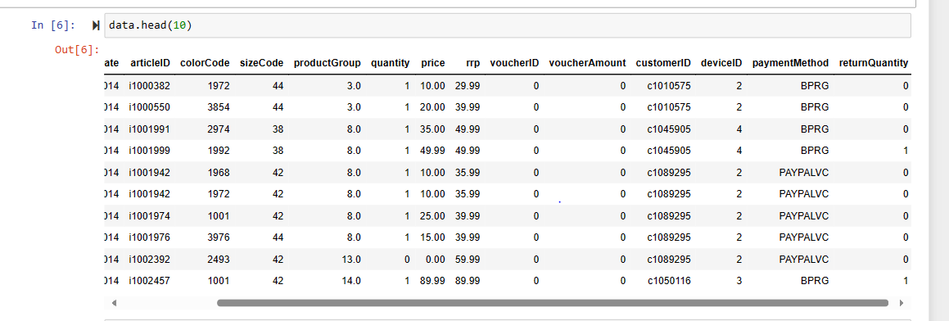
Data Collection & Overview A fashion distributor sells articles of particular sizes and colors to its customers. In some cases, items are returned to the distributor for various reasons. The order data and the related return data were recorded over a two-year period. The aim is to use this data and machine learning to build a model that enables a good prediction of return rates. Kaggle - https://www.kaggle.com/datasets/oscarm524/predicting-returns-of-discounted-articles-sales

Slide 8
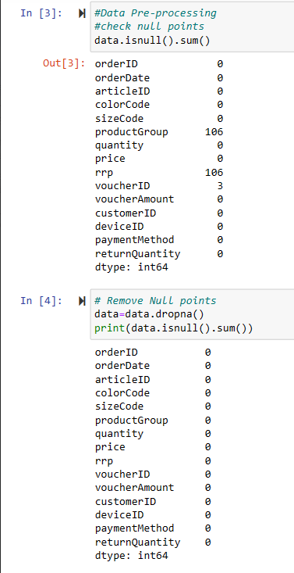
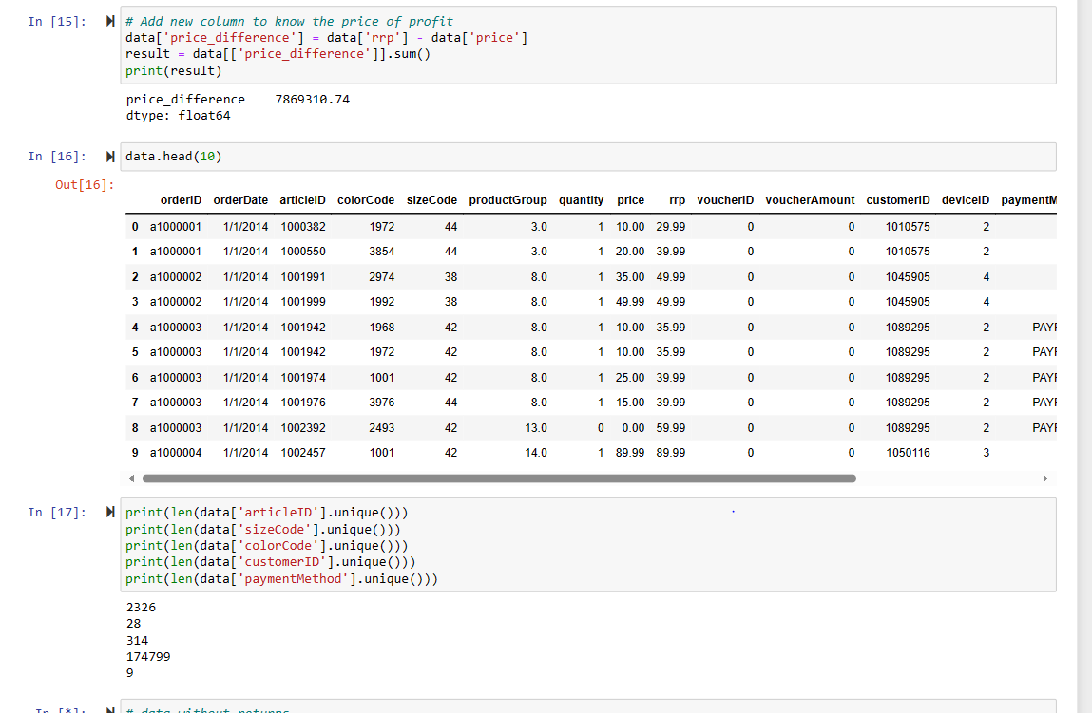
Data Pre-processing Checked and removed Null points and added new column price difference to get know the profit.

Slide 9
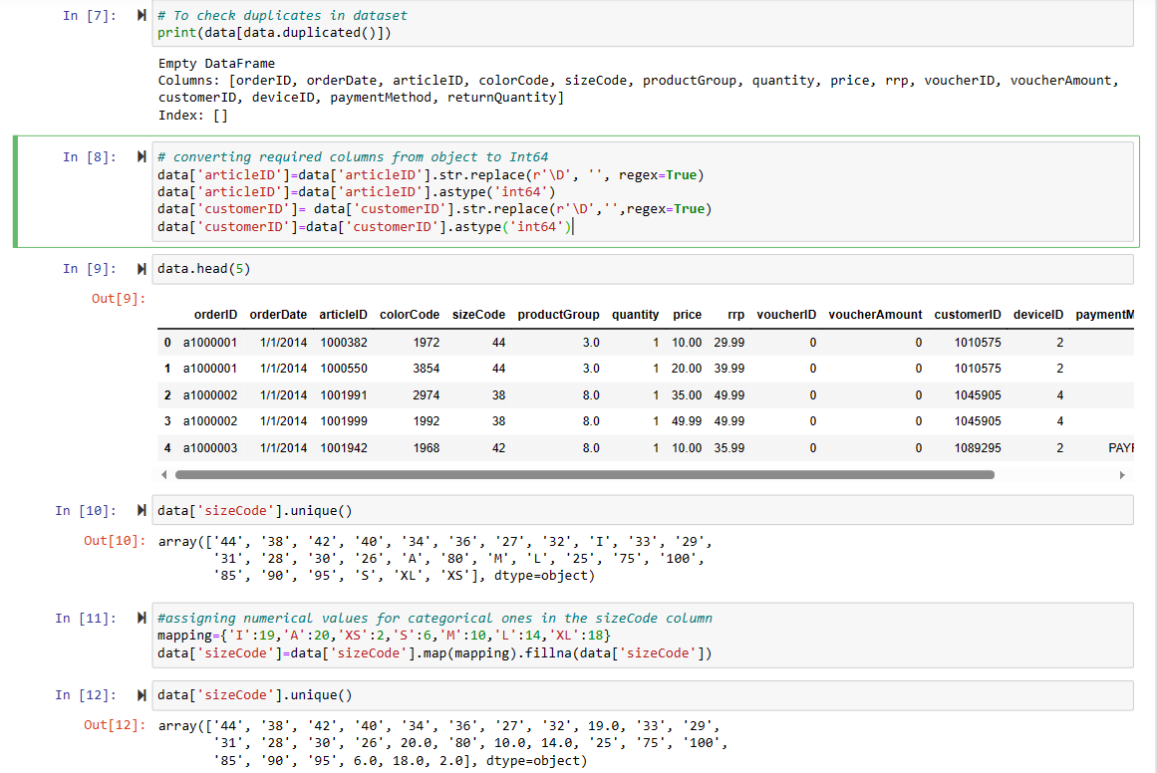
Data Pre-processing Removed Duplicates and converted object data types into integers for better analysis

Slide 10
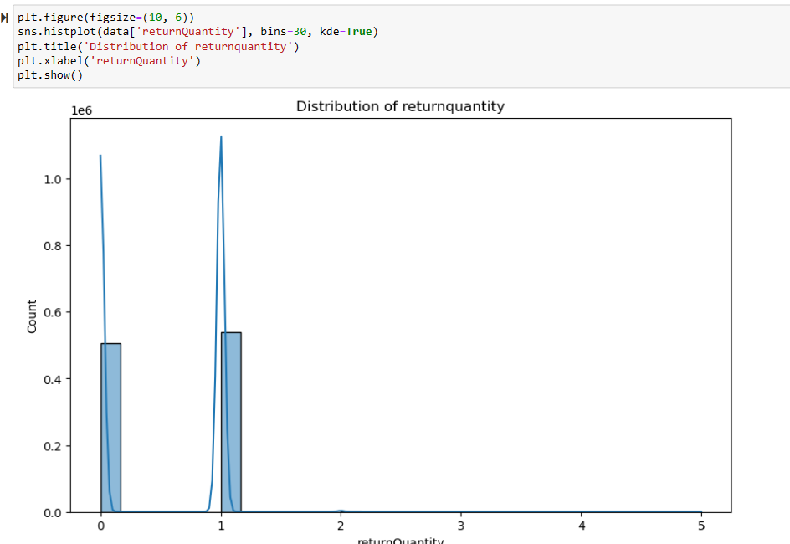
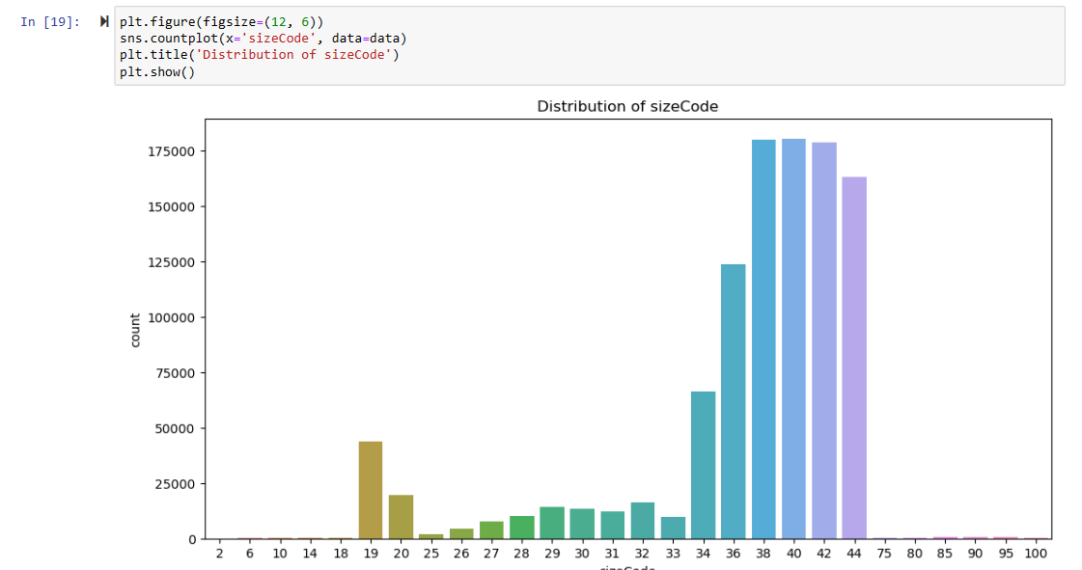
Data Analysis distribution of Return-quantity and Distribution of SizeCode

Slide 11
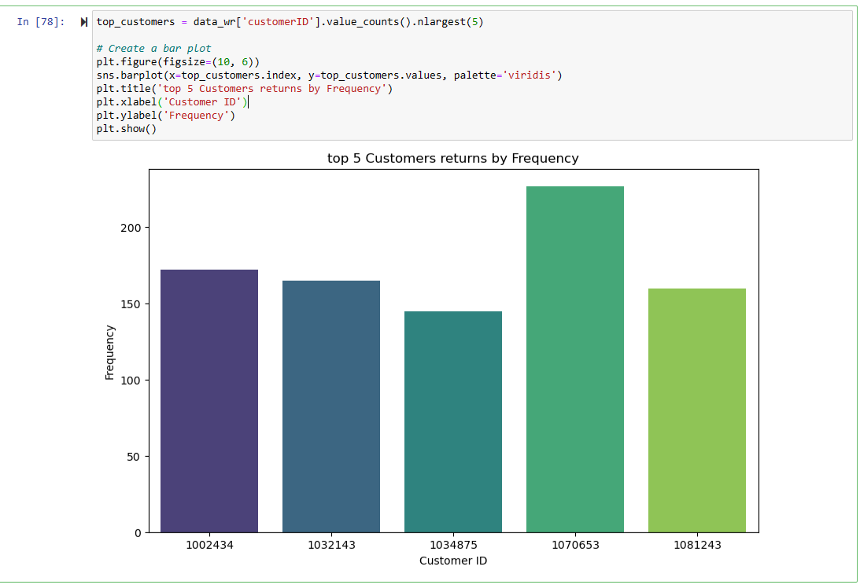
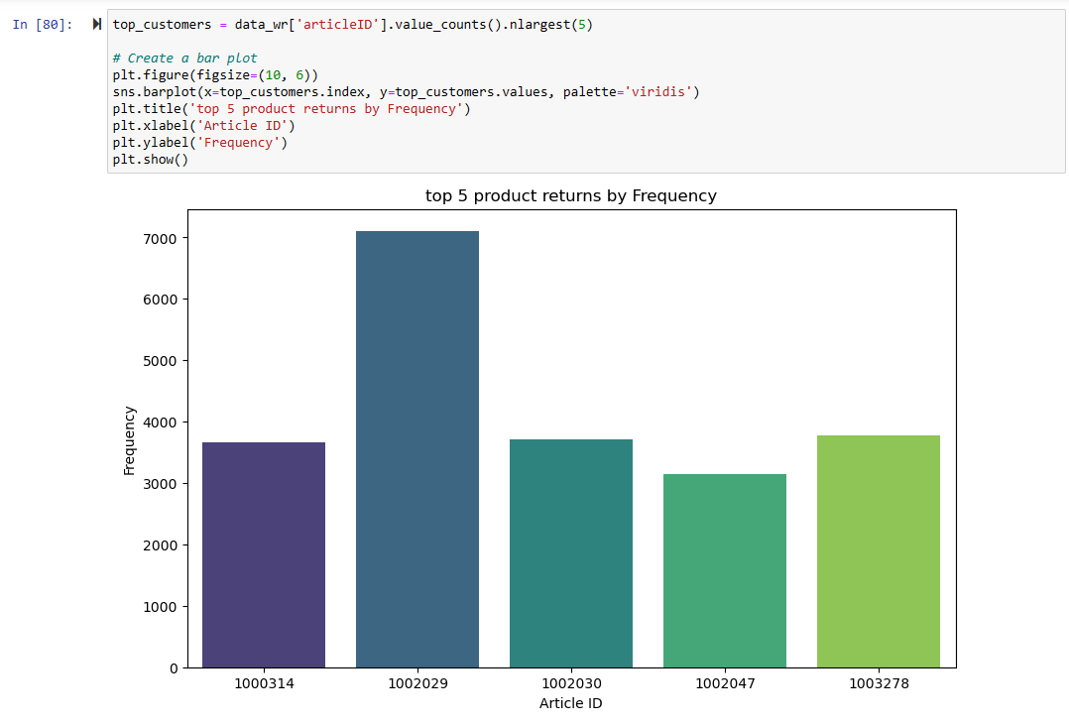
Data Analysis Highest returns by customer(1070653) Highest return by product(1002029)

Slide 12
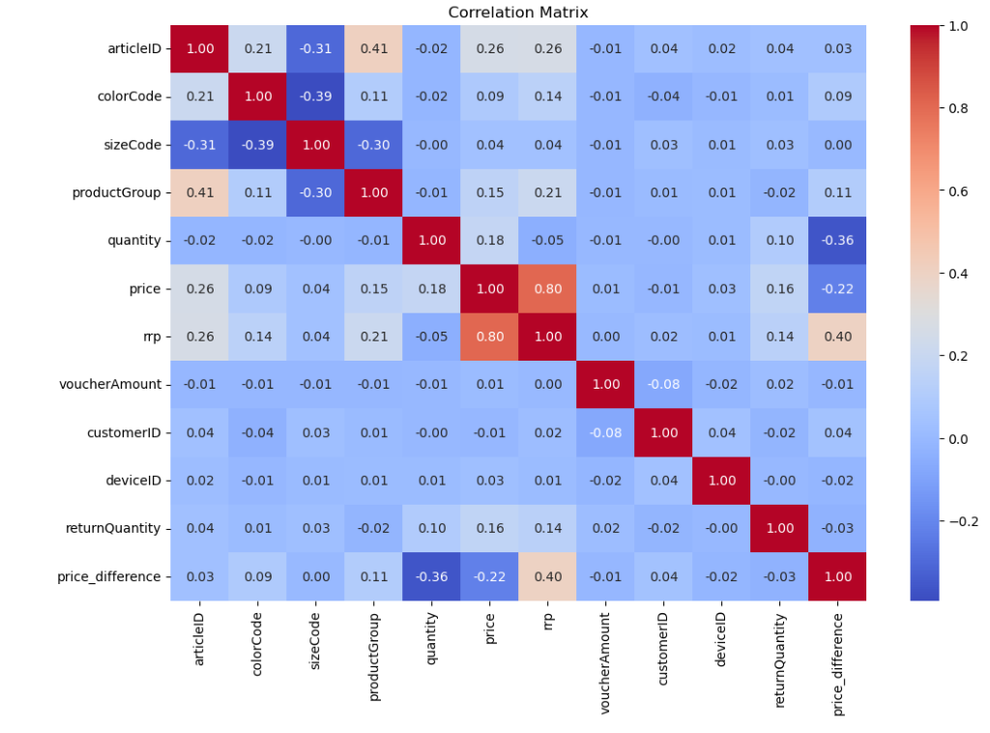
Data Analysis The return quantity positively correlated with article-ID, colorCode, sizeCode, quantity, and price.

Slide 13
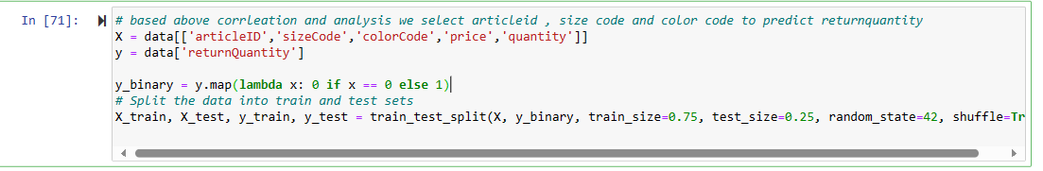
Preparing data for Model Based on the correlation analysis we select the article, size, colorCode to predict return quantity, we have divided 75% of the data 25 testing. We have converted target variable into two categories 0 is not returned and remaining are Returned.

Slide 14
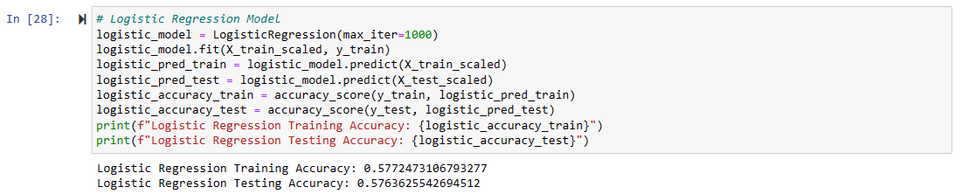
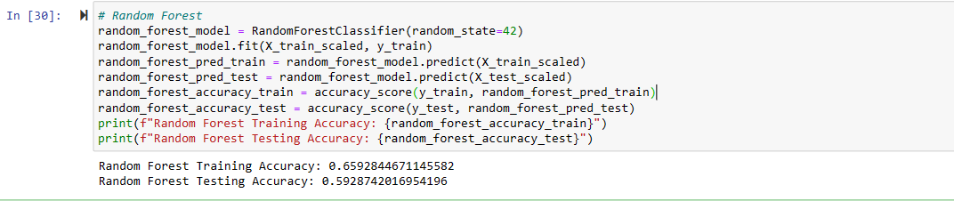
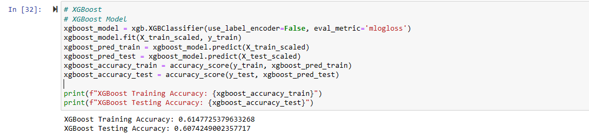
Model Selection The categorizing articles with size code and color code into 'returned' and 'not returned’. As our target variable is categorical so, we have chosen Logistic Regression, Random Forest, and XGBoost. Below are the accuracy scores for training and testing.

Slide 15

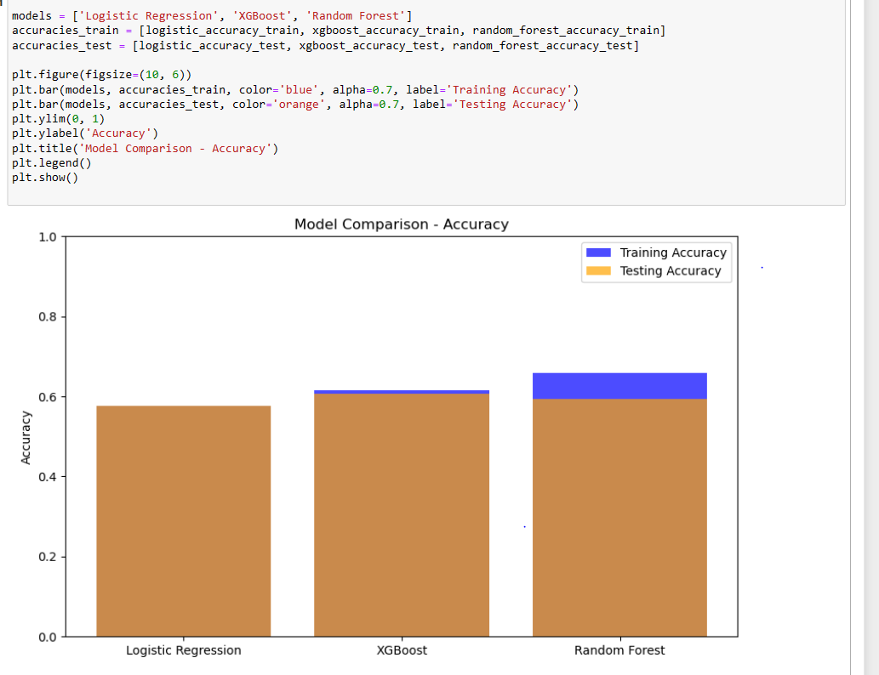
Model comparison Based on comparing all models by their accuracy we have selected random forest Model, Training Accuracy, and Testing Accuracy are high.

Slide 16
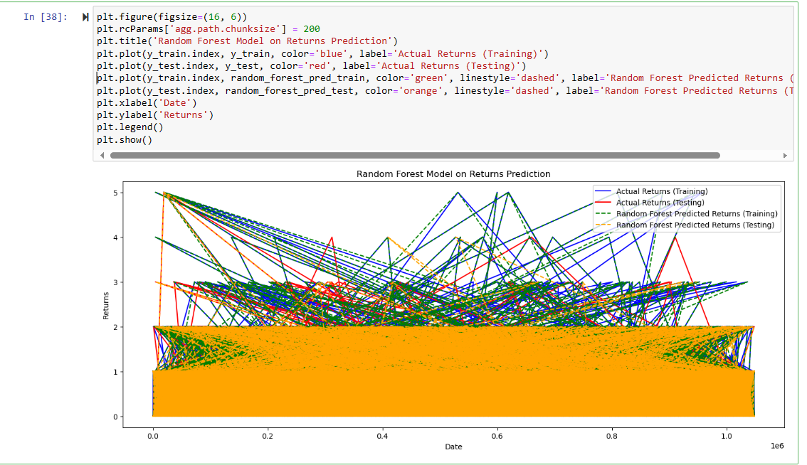
Random Forest Model on Return Prediction

Slide 17
Conclusion
Project Jupyter Notebook- ReturnPredication
By this Project, By analyzing key factors such as product, color and size we can proactively identify and
address inventory challenges, effectively reducing return-related losses.
This data-driven approach not only enhances operational efficiency but also fosters greater customer
satisfaction by minimizing the occurrence of returns.
Solutions:
Buy-Online- Return- Instore solution are implementing by big companies which helps reduce fraud returns.
Engaging with customer return desk online or instore to take feedback and now more about returns helps to understand returns reasons.

Slide 18
Questions And Answers
Preferred Time – 12.30 pm

